Slide 1


Multimodal Emotion Expression Capture Workshop
SICSS Amsterdam, 11-06-2024
Malte Lüken

Slide 2
Agenda
13:00 – 13:50 Introduction to MEXCA
13:50 – 14:00 Break
14:00 – 14:30 MEXCA hands-on tutorial
14:30 – 14:45 Introduction German Federal Debates dataset
14:45 – 15:00 Discussion and wrap up

Slide 3


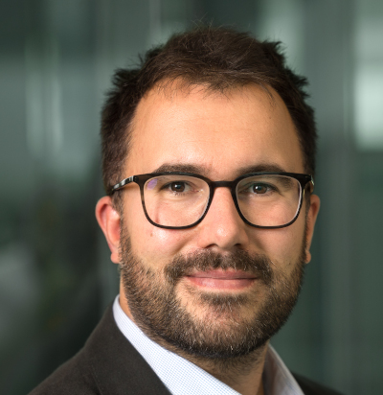
Introduction to MEXCA

Slide 4
Overview
The need for automated multimodal emotion expression capture
The MEXCA pipeline
Facial modality
Voice modality
Speech/text modality
A short example
Conclusion
Lüken, M., Moodley, K., Viviani, E., Pipal, C., & Schumacher, G. (2024, January 18). MEXCA - A simple and robust pipeline for capturing emotion expressions in faces, vocalization, and speech. PsyArXiv. https://doi.org/10.31234/osf.io/56svb

Slide 5
Automated emotion expression capture
Emotion expressions are variable and context-dependent
Unimodal measurement often not sufficient to identify emotional states
Differences between the lab and the “wild”
→ Robust and generalizable emotion research requires large multimodal data sets from different samples and contexts on a fine time-scale

Slide 6

Automated emotion expression capture
Goal of MEXCA project: Develop a pipeline that
Identifies persons (speakers, faces) and transcribes speech to text
Captures emotion expressions from faces, voices, and speech content (no emotion label classification)
Is efficient, i.e., is fast, and can be used on larger scale
Is easy-to-use, i.e., easy installation/deployment, good defaults

Slide 7
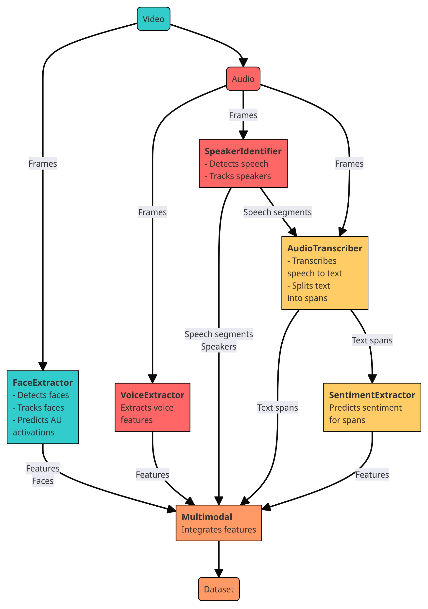
The MEXCA pipeline
Takes video as input
5 modular components can be combined into pipeline
Returns data frame with captured emotion expression features
frame | time | feature_1 | …
0 | 0.04 | 1.24 | …
1 | 0.08 | 1.35 | …
… | … | … | …

Slide 8
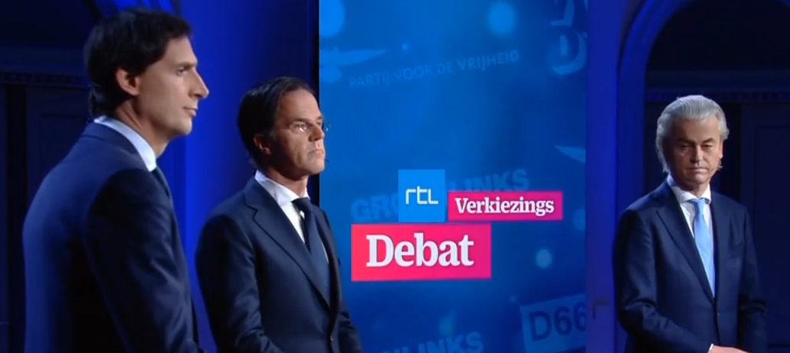
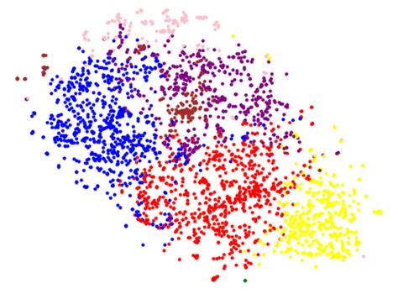
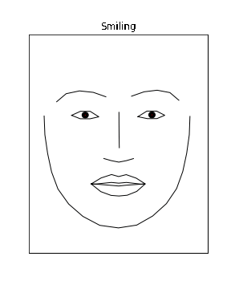
The MEXCA pipeline
FaceExtractor: Takes a video file as input
Detection: Faces displayed in the video frames are detected with a pretrained MTCNN model
Encoding: Faces are extracted from the frames and encoded into an embedding space using InceptionResnetV1
Identification: IDs are assigned to faces by clustering the embeddings with spectral clustering (k-means)
Extraction: Facial features (landmarks, action units) are extracted from the faces using a graph neural network
Face 1
Face 3
Face 2

Slide 9




The MEXCA pipeline
SpeakerIdentifier: Takes an audio file as input
Segmentation: Speech segments are detected using overlap-aware segmentation(this step includes voice activity detection)
Encoding: Speaker embeddings are computed for each speech segment using ECAPA-TDNN
Identification: IDs are assigned to speech segments based on agglomerative clustering
Speaker 1
Speaker 3
Speaker 2

Slide 10
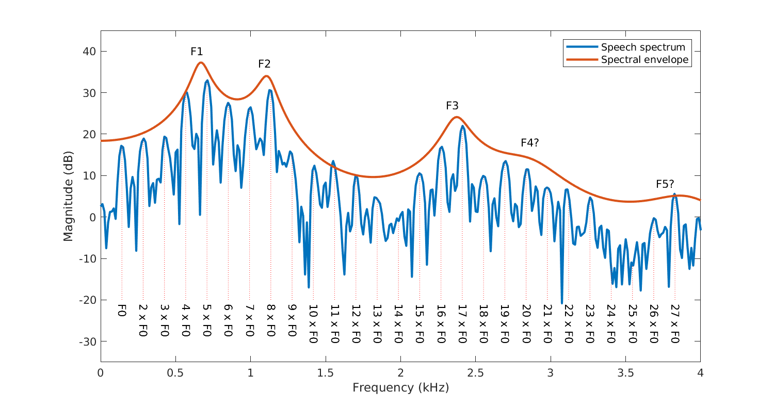
The MEXCA pipeline
VoiceExtractor: Takes the audio file as input
Extracts voice features from extended Geneva Minimalistic Acoustic Parameter Set (eGeMAPS)
AudioTranscriber: Takes the audio file and speech segments as input.
Transcribes the speech segments to text using a pretrained Whisper model
Transcriptions are aligned with speaker segments
Transcriptions are split into sentences with regular expression
SentimentExtractor: Takes the transcribed text sentences as input
Predicts sentiment scores (positive, negative, neutral) for each sentence using a pretrained multilingual RoBERTa model.
“This is the finest deal we’ve ever seen!”
(0.84)

Slide 11
Software
Python package:
pip install mexca
github.com/mexca/mexca
Easy installation via Docker containers for exploration and testing
Full installation for large scale data processing
Components can use GPU acceleration if available

Slide 12
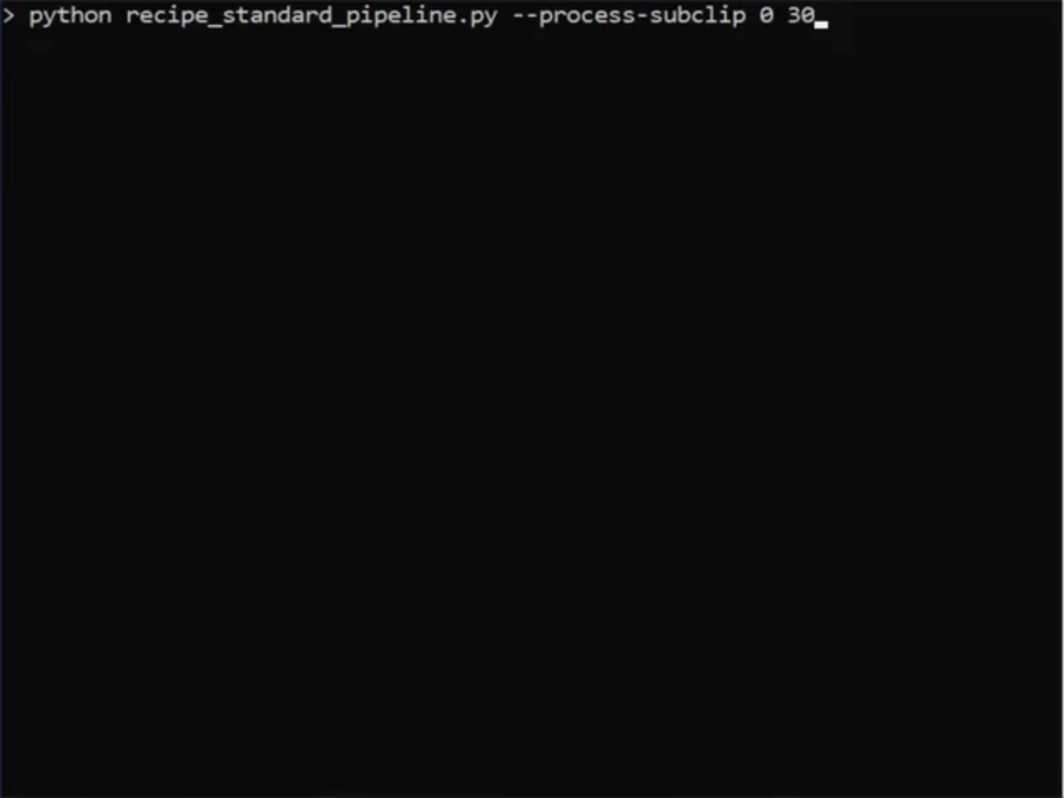
A short example

Slide 13
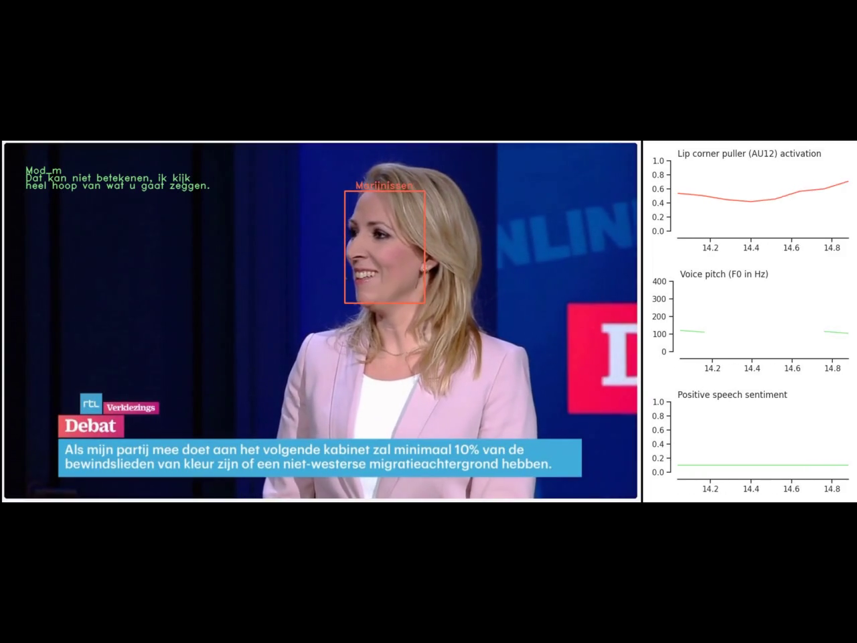
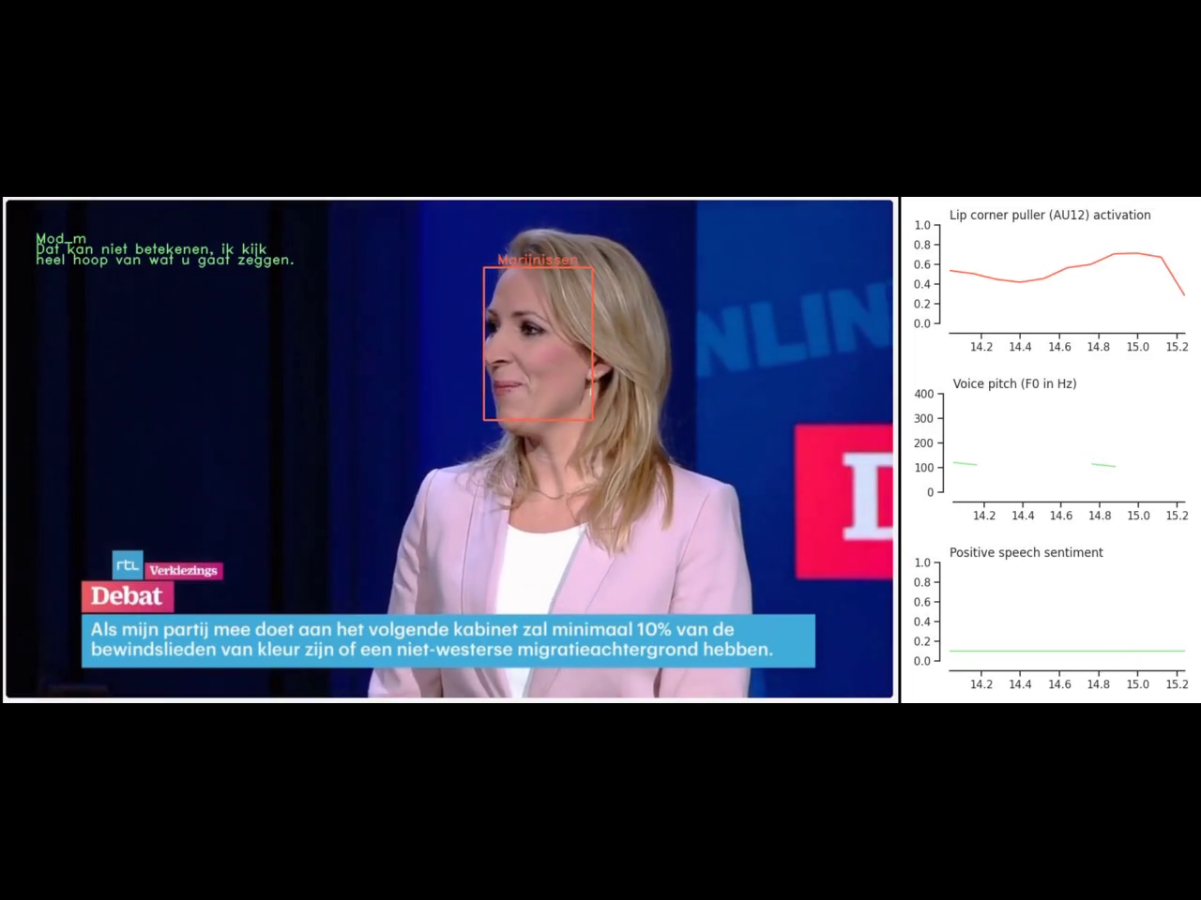
A short example

Slide 14
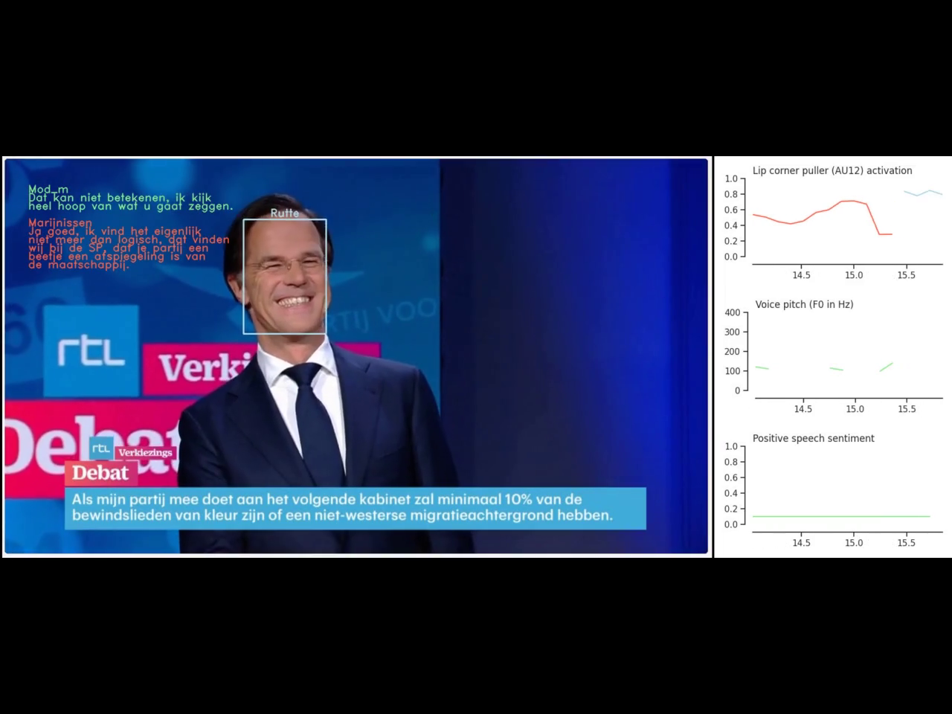
A short example

Slide 15
Applying MEXCA to large data sets
Use GPUs for faster inference (e.g., via high-performance computing or cloud infrastructure)
Split long videos to avoid memory issues
Check for video and audio quality
Video and audio resolution should be sufficient (640 to 1920 px, > 16000 Hz)
Faces should have sufficient size for accurate AU predictions (> 45 px)
Check for number of faces and speakers (< 10)
Check for spoken languages (most common/Western languages supported)
Facial analysis and transcription take most computational resources

Slide 16
Conclusion
MEXCA enables researchers to capture emotion expressions from three modalities on a fine time scale in the “wild”
→ Opens new avenues in emotion research
Limitations:
Video and sound quality
Number of faces and speakers must be known
Post-hoc face and speaker labeling
Accuracy of integrated models

Slide 17
References
Barbieri, F., Anke, L. E., & Camacho-Collados, J. (2022). XLM-T: Multilingual language models in twitter for sentiment analysis and beyond. arXiv. https://doi.org/10.48550/arXiv.2104.12250
Barrett, L. F., Adolphs, R., Marsella, S., Martinez, A. M., & Pollak, S. D. (2019). Emotional expressions reconsidered: Challenges to inferring emotion from human facial movements. Psychological Science in the Public Interest, 20(1), 1–68. https://doi.org/10.1177/1529100619832930
Bredin, H. (2023). pyannote.audio 2.1 speaker diarization pipeline: Principle, benchmark, and recipe. Interspeech 2023, 24th Annual Conference of the International Speech Communication Association, 1983–1987. https://doi.org/10.21437/Interspeech.2023-105
Esler, T. (2023). Face recognition using Pytorch [Computer software]. https://github.com/timesler/facenet-pytorch
Eyben, F., Scherer, K. R., Schuller, B. W., Sundberg, J., Andre, E., Busso, C., Devillers, L. Y., Epps, J., Laukka, P., Narayanan, S. S., & Truong, K. P. (2016). The Geneva minimalistic acoustic parameter set (GeMAPS) for voice research and affective computing. IEEE Transactions on Affective Computing, 7(2), 190–202. https://doi.org/10.1109/TAFFC.2015.2457417
Luo, C., Song, S., Xie, W., Shen, L., & Gunes, H. (2022). Learning multi-dimensional edge feature-based au relation graph for facial action unit recognition. Proceedings of the Thirty-First International Joint Conference on Artificial Intelligence, 1239–1246. https://doi.org/10.24963/ijcai.2022/173
Radford, A., Kim, J. W., Xu, T., Brockman, G., Mcleavey, C., & Sutskever, I. (2023). Robust speech recognition via large-scale weak supervision. Proceedings of the 40th International Conference on Machine Learning, 28492–28518. https://proceedings.mlr.press/v202/radford23a.html
Schroff, F., Kalenichenko, D., & Philbin, J. (2015). FaceNet: A unified embedding for face recognition and clustering. 2015 IEEE Conference on Computer Vision and Pattern Recognition (CVPR), 815–823. https://doi.org/10.1109/CVPR.2015.7298682
Zhang, K., Zhang, Z., Li, Z., & Qiao, Y. (2016). Joint face detection and alignment using multitask cascaded convolutional networks. IEEE Signal Processing Letters, 23(10), 1499–1503. https://doi.org/10.1109/LSP.2016.2603342
://doi.org/10.1111/pops.12693

Slide 18

Check out the preprint!
https://github.com/mexca/mexca
m.luken@esciencecenter.nl
+31 20 460 4770

Slide 19
MEXCA is open-source software – we are looking for contributors!

Slide 20
German Federal Debates Dataset

Slide 21
German Federal Debates Dataset
Available on Hugging Face Hub: https://tinyurl.com/german-debates
Output from MEXCA pipeline for 12 federal election debates from the years 2002 to 2021
Stored as 2 parquet files
Has “filename” column with debate identifier
Variables are documented in documentation of mexca package
Notebook for efficient loading and processing in Python: https://tinyurl.com/data-loader-python
Script for efficient loading and processing in R: https://tinyurl.com/data-loader-r

Slide 22
German Federal Debates Dataset
Things to keep in mind:
Columns “face_label” and “segment_speaker_label” refer to different persons in different debates
Some facial action units are predicted with low accuracy
Many features are not normally distributed → transformations
Lots of missing data!

Slide 23
German Federal Debates Dataset
Suggestions for analyses:
Look at structure of emotion expressions → factor analysis, dimensionality reduction
Look at differences between speakers
Look at interactions between speakers
Look at temporal dynamics

Slide 24
Thank you!

